Slide 1

Stages for research
Dr Alveen Singh
Department of Information Technology
Research skills/Project 3A
Advanced Diploma in ICT/B. ICT
Semester 1 2023

Slide 2
Content
The research process
Components of a research proposal

Slide 3
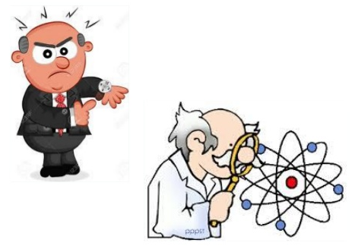
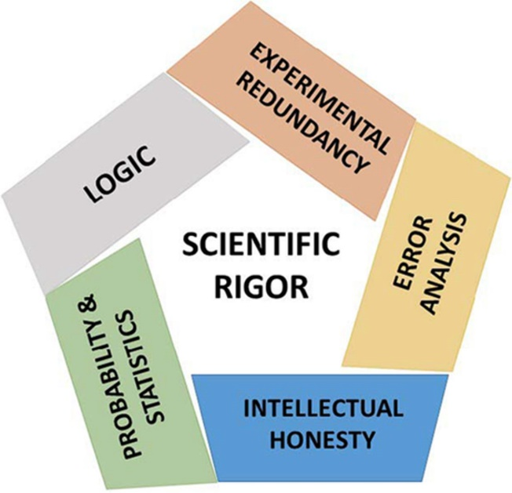
1. The research Process
Lilford, 2015
The basic steps that must followed
The steps are generic and essential stages, undertaken in a systemic manner
A sound research process ensures
high quality and plausible research
as well as scientific rigour.
American society of microbiology

Slide 4
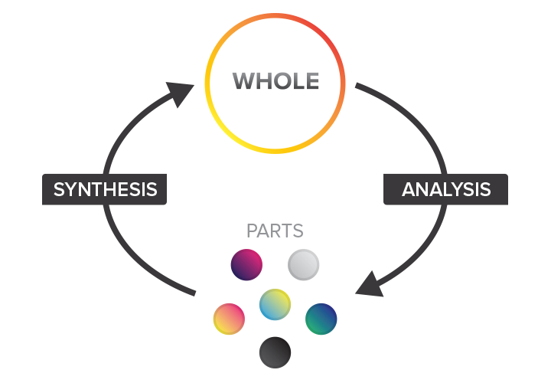
Basic steps of the research process
Identifying the problem
Review relevant literature
Draft research questions, objectives, and hypotheses
Determine the research strategy
Data collection and sampling
Data analysis
Writing up findings
hermeneutic circle
Timmer, 2021

Slide 5
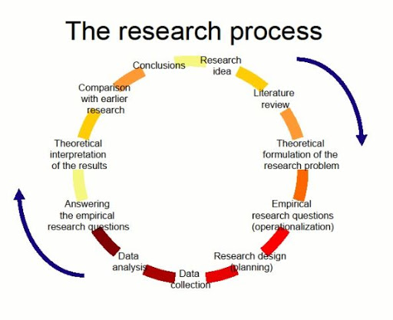
Vumultun.com, 2020

Slide 6



1. Identify the problem
A research problem is complicated and impacts on a
group
It is not a straightforward problem and the solution is not straightforward
There are multiple solutions to a research problem
For a research problem, there is a difference between the current situation and the ideal situation.
  The reasons for this difference are either unknown or not well understood.
Once the problem is understood, a clear statement of the problem should be formulated.
Thereafter, the research question and objectives
can be formulated

Slide 7
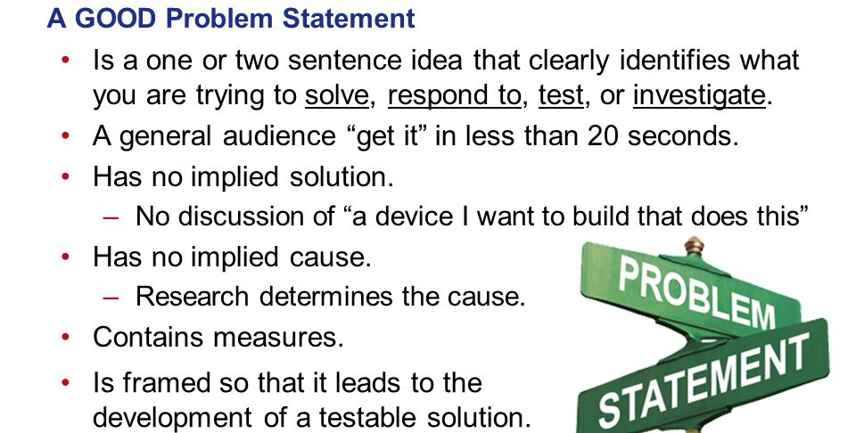
Parmiter, 2016

Slide 8
The research problem should tell the reader about
“What is the problem?”
“Where is it occurring?”
“Why is it occurring”
“When is it occurring”
Remember that a reader might read the work 1000 years from today
See example in lecture note

Slide 9
2. Review of relevant literature
Why is it important to start here?
  To understand the state-of-the-art
  To understand what work has already been done
    and the effectiveness
  To prevent setting up research for problems that have already been solved
“Such a review, not only provides exposure to a larger body of knowledge but also equips with enhanced knowledge to efficiently follow the research process. Through a proper review of the literature, the researcher may develop the coherence between the results of his study and those of the others” (iedunote, 2021)

Slide 10
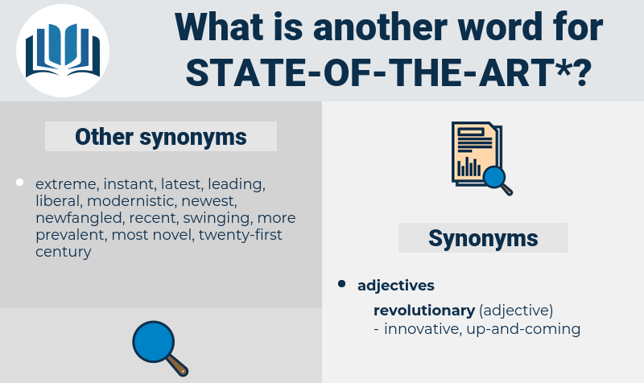

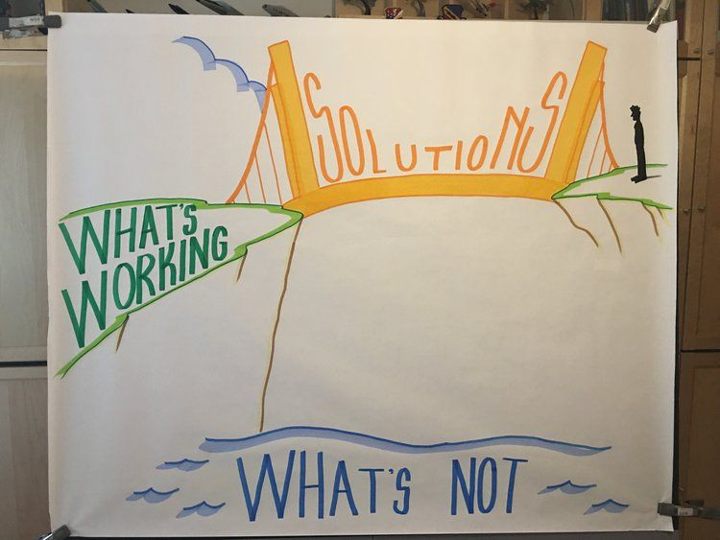
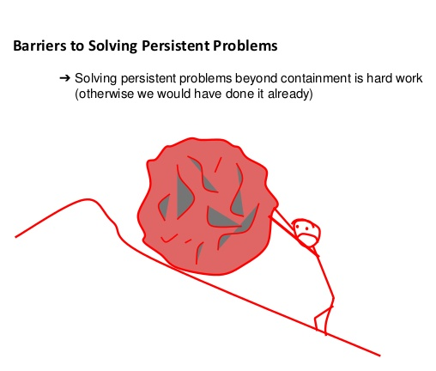
Enz, 2020
Liegel, 2020

Slide 11

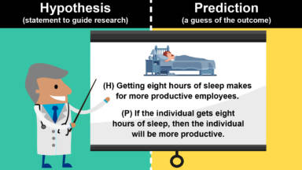
Draft research questions, objectives, and hypotheses
A research question is the mainstay of the
entire research undertaking
The objectives are the milestones that need to be achieved
along the way
Hypothesis may be posed instead of research
questions
these are statements that the researcher makes
and each hypothesis can be proven true or false
Aruma.com
Yourdictionary.com

Slide 12
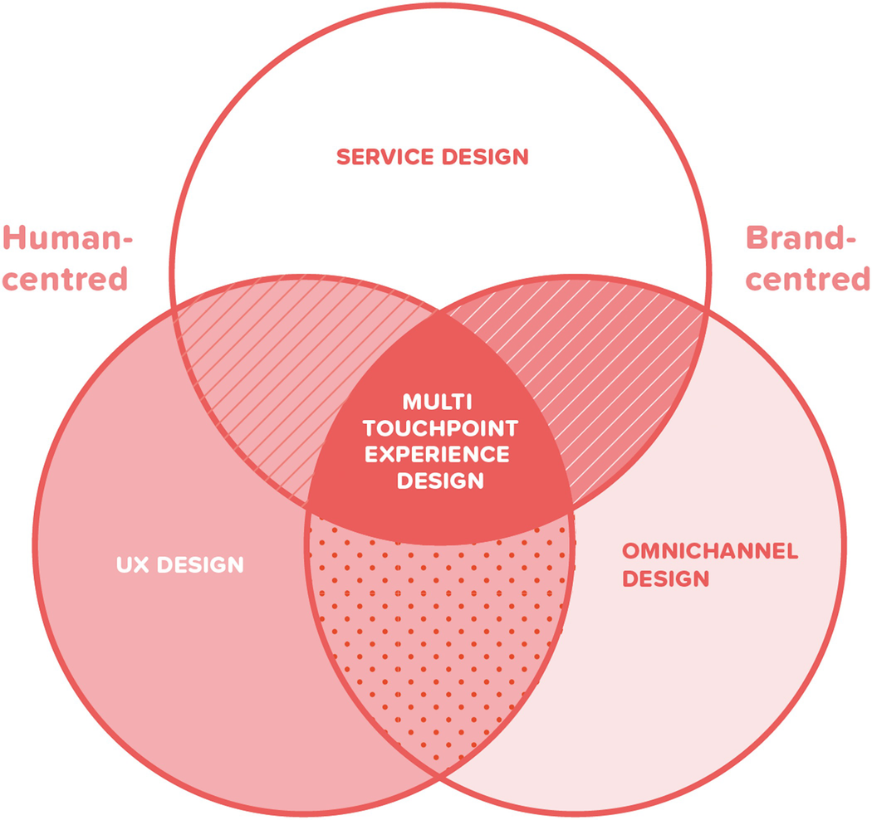
The research question is stated beginning with:
how and why – qualitative research
what – quantitative research
The research question should incorporate the variables or aspects of concern in the study
van de Sand, 2019

Slide 13
Example RQs
What are the critical factors for successful implementation of an efficient on-line registration system?
Can ML assist in identifying useful predictors for reliability of mobile apps?
What is an effective approach for improved business analysis of public eservice systems?

Slide 14
Example Hypothesis
H0: IoT based greenhouse environment monitoring will result in improved monitoring of environmental conditions
H1: IoT based greenhouse environment monitoring will not result in improved monitoring of the environmental conditions

Slide 15
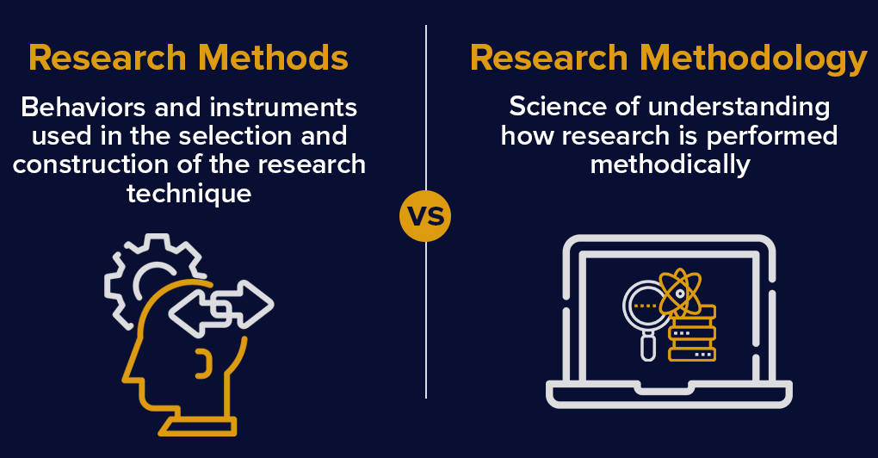
4. Determine the research strategy
The researcher has several options
  Qualitative, quantitative, mixed, design research, experiment, survey,
The research strategy should be carefully considered and planned as this is the vehicle to achieve the research objectives and eventually reach an answer for the research question
Surbhi, 2016

Slide 16

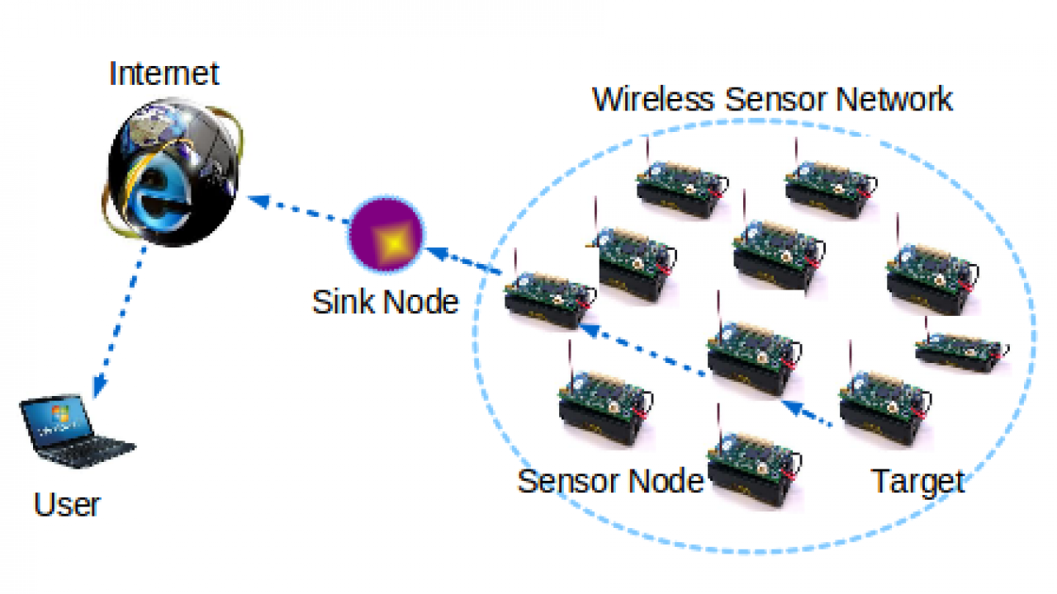

Data collection (and sampling)
The main types of data are qualitative and quantitative.
  Qualitative data is usually collected from people, coded into some format, and then analyzed for the purpose of research
  Quantitative data is usually numerical
Microcontrollers lab.com

Slide 17
Data collection can be either from a primary or secondary source.
  The secondary source includes data that has already been analyzed and is available in the form of reports, publications, online data bases and so on.
  Primary data is generated for the first time in a study.
    Online datasource (e.g. Kaggle for Data Science)

Slide 18
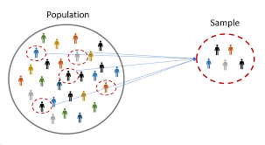
Sampling is the task of selecting a small number of items (sample) for the research from a much larger group (population).
The research is conducted using the smaller sample and the results are generalized to the population.
Therefore, it is vitally important that the sample is an accurate representation of the whole population. –for this apply sampling techniques
The opposite of a sample is census whereby the entire population is included in the research.
Omniconvert.com

Slide 19
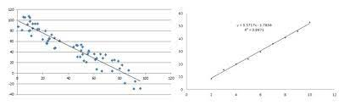
6. Data analysis
A researcher analyses the data searching for patterns and trends, to summarize the data and apply techniques to understand the data and arrive at findings.
Quantitative data analysis utilizes statistical techniques and formula to arrive at results. Data collected in different formats are converted to numbers prior to analysis and arriving at results.
Qualitative data is usually coded into a smaller, more manageable format before analysis can begin.
Dataversity, 2018

Slide 20
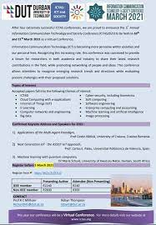


Writing up findings
At the end of the research, the findings need to be communicated to the IT research and practitioner community.
This comes in the form of conference presentations and proceedings, journal publications and book and book chapters.
It is important for the advancement of the field.

Slide 21
2. The components of a research proposal
What is a research proposal?
  A plan to conduct the research

Slide 22
Uses of the research proposal
The proposal is usually peer reviewed
PhD or Masters student needs to submit to Research Committee for approval.
The research proposal has to be of good quality. There are limited students allowed into PhD and Masters programs and a limited funding allocation. Hence, the proposal is an important selection tool.

Slide 23
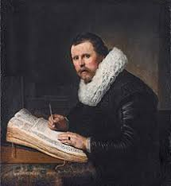

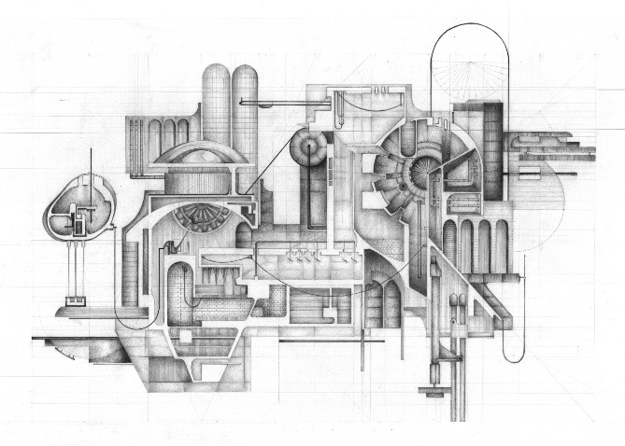
To show that the intended research has the potential to make a contribution to the field
To provide a detailed plan for research design for achieving the objectives
To show that the student/writer has adequate scientific ability and knowledge to undertake the study
To show that the research can be achieved with the allocated financial and time constraints
Britannica.com
Architizer.com
Wikkipedia.com

Slide 24
Sections of a research proposal
Topic/title
Context
Problem statement
Aim
Research question/hypothesis
Objectives
Literature review
Research methodology
Expected contribution
Plan of research activities
Budget
Structure of thesis (Chapter)
Ethics approval section
See Pg2a

Slide 25
Title
Should be concise, descriptive of the study and exciting. The aim should be embodied in the title.
  Real-time detection of credit card fraud using ensemble deep learning algorithm
  Guidelines for improved business analysis of public service websites
  Modeling user experience in human-robot interaction
  Identifying students at risk using ensemble machine learning model

Slide 26
Context of study:
Describe the domain of the research i.e. what area in the literature do you aim to contribute towards?
Introduce the main variables of the study (usually 2 or 3)
Briefly show gaps in literature concerning those variables

Slide 27
Research Problem:
What are the challenges?
What is current literature lacking or gaps in literature?
Main research question

Slide 28
Aims and objectives:
What do you plan to do to solve identified problems?
How will you solve the problems? i.e. state the objectives of the study (3)
Introduce your sub-research questions

Slide 29
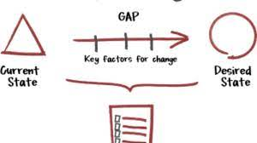

Literature review
Synthesis of literature to make a case for the need for your study.
Show state-of-art
Show “gaps”
Growadvisors.com

Slide 30
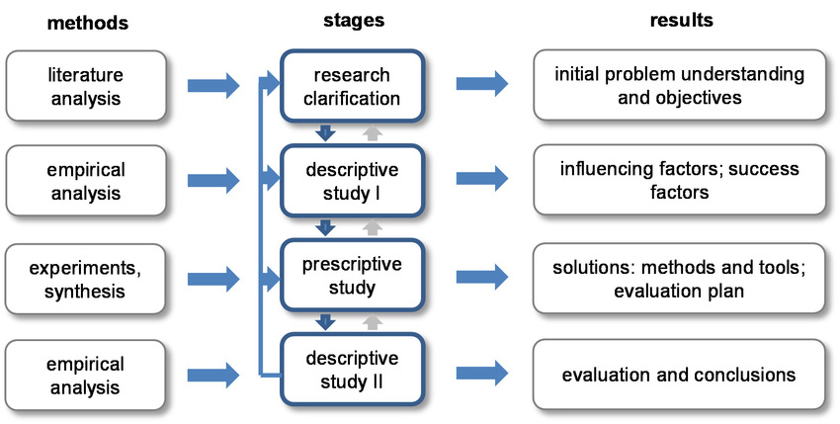
Research methodology:
Research type, research strategy, research method(s), data collection and data analysis approach, plan to validate findings.
Researchgate.com

Slide 31

Expected contributions
Briefly state how your study will contribute towards the body of knowledge
Open.edx.eu

Slide 32
Skills that need to be developed before writing a good research proposal
Knowledge of the state-of-the-art in the intended area of research. This includes new developments evident in literature and methodology
Scientific writing and grasp of nomenclature relevant to the field
Critical thinking to provide a good analysis, evaluation and synthesis of literature
Communication skills to produce a high quality write-up

Slide 33
The literature review assists the researcher in ___
A. Formulating a research question and objectives
B. Determining the research strategy
C. Understanding the state-of-the-art of an area
D. Writing the research proposal
Which of the following least applies to sampling?
A. Selecting a small number of items from a much larger group
B. The entire population is included in the research
C. the research results are generalized to the population
D. the sample is an accurate representation of the whole population

Slide 34
Questions and comments are welcome: lindelweyizizwem@dut.ac.za

